Slide 1
Linkedin Analysis
Group 2

Slide 2
objective
•This is a unsupervised machine learning project.“The goal is to recommend relevant job openings on “linkedin”.
•The data file contains 11 features about 1127 companies.
•The data set includes the following variables:
1.Job_Name
2. Company
3. Location
4. State
5.Country
6.Job_type
7. Employees_Avg
8.Followers_Numbers
9. New Applicants
10. Industry
11. Involvement

Slide 3
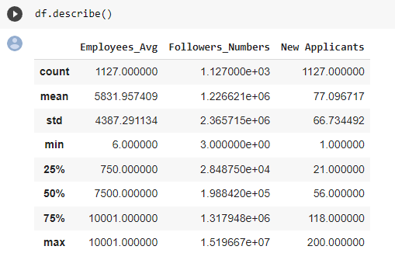
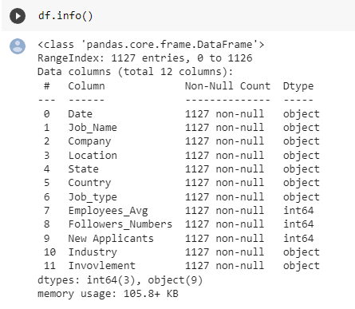
Data Set Analysis
The Data set includes the following variables:

Slide 4
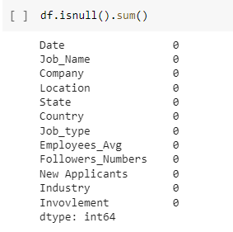
Inferences from Data Set

Slide 5
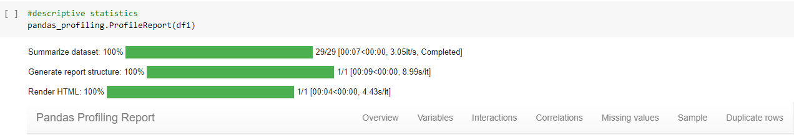
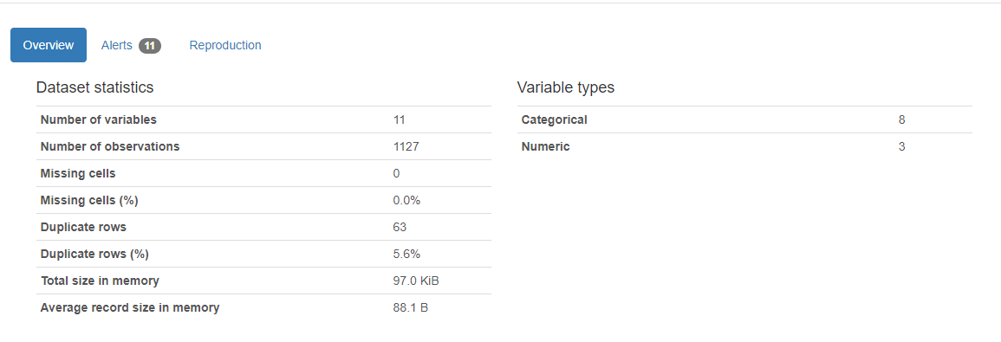
Visualization -Univariate Analysis

Slide 6



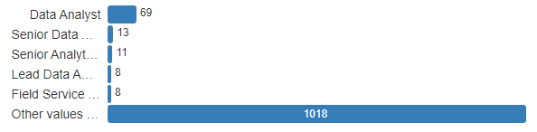
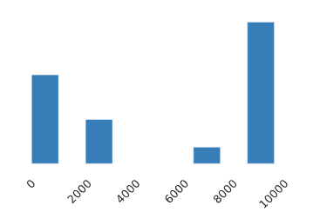

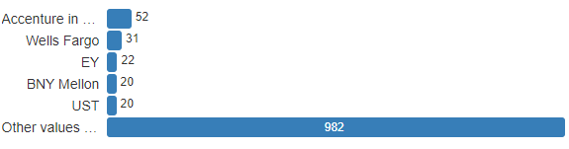


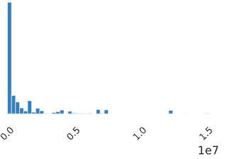
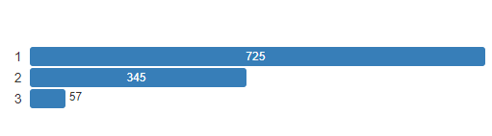

Slide 7


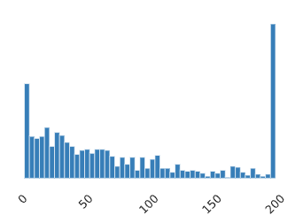
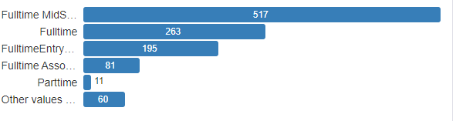

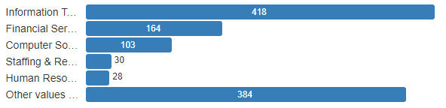

Slide 8
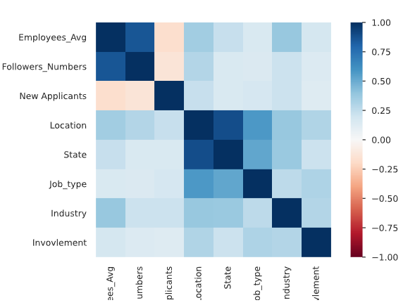
Visualization -Multivariate Analysis
Correlation

Slide 9
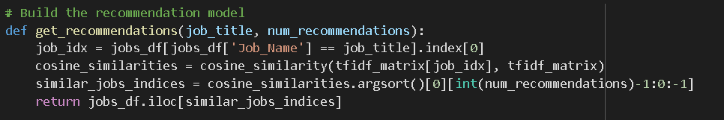
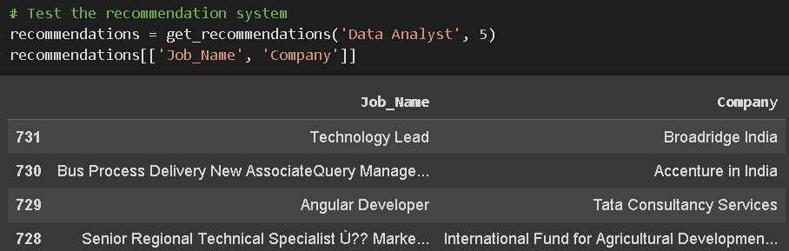
Model Building

Slide 10
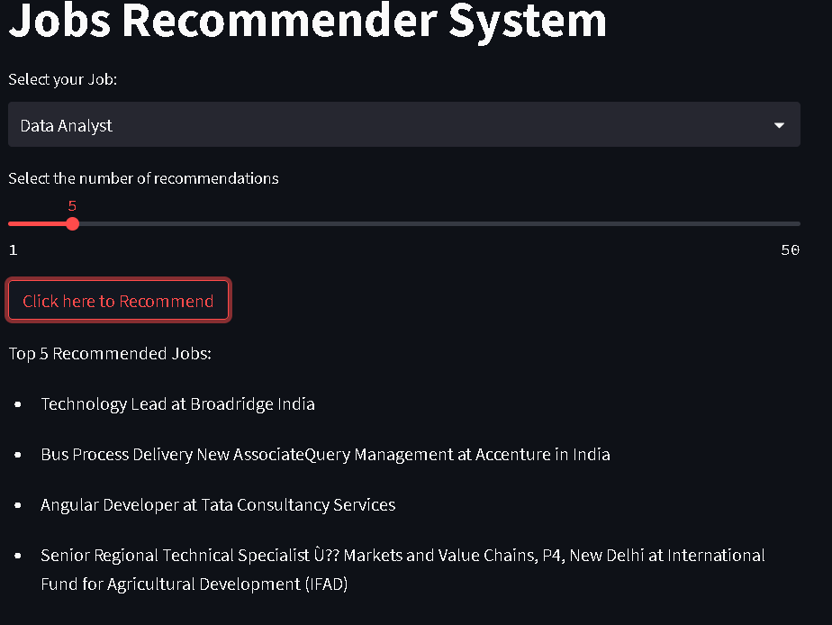
Model Deployment

